Slide 1
OPEN IIT PRODUCT DESIGN-2022
Team 48

Slide 2
Problem Statement
Differently abled people find it difficult to integrate into society due to their inability to communicate through established methods.
This makes them dependent on others for many of their needs. Also, other people find it hard to communicate with them through our ideas.
We plant to address this issue by designing a pair of devices meant to foster communication.

Slide 3
Motivation
People who are hearing-impaired face considerable challenges. They find difficulties to express their thoughts or to convey their message to other people so that the researchers attempt different ways in order to produce a device that may give them a better quality of the life to work in basic situations. They face lots of problems such as:
When someone realizes they are interacting with a hearing-impaired person, they often switch to a slower form of speech. So, slowing it down intentionally can result in miscommunication.
Most of the time Job interviews are stressful situations; now consider being hearing impaired. Those who are hard of hearing or deaf may sometimes feel completely ignored when they reveal their hearing status.
Studies reveal that deaf people are around twice as likely to suffer from psychological problems such as depression and anxiety. Research suggests that this stems from feeling of isolation.
Visually impaired people face troubles due to inaccessible infrastructure and social challenges
The biggest challenge for a blind person, especially the one with the complete loss of vision, is to navigate around places
Blind people have a tough time finding good reading materials in accessible formats. The Internet is mostly inaccessible for blind people

Slide 4
Existing Products
Oton Glasses
Converts text into speech. Glasses contain two tiny cameras and earphones on the sides. The photo gets transmitted through Raspberry Pi cloud system, analyzed and voice is played through an earpiece.
LyriQ Text-to-Speech Reader:
The LyriQ Assistive Text-to-Speech Reader assists people living with blindness or vision impairments by scanning printed documents and reading them out loud.

Slide 5
OUR PRODUCT The idea is a product design of a headwear, which comprises of a camera and a Raspberry Pi module on the backend, which captures sign language and converts it into text/audio. This helps mute people who doesn’t know sign language and it also helps to make the communication between differently abled people and others smoother.
PARTS OF OUR PRODUCT
Cap
The base headwear acts as the part to which the raspberry Pi system, the camera and the wires attaching these will be placed
Raspberry Pi
Raspberry Pi is a series of small single-board computers (SBCs) which is widely used in many areas, such as for weather monitoring, because of its low cost, modularity, and open design. It is typically used by computer and electronic hobbyists, due to its adoption of the HDMI and USB standards.

Slide 6
Raspberry Camera
This raspberry pi camera has a 5-megapixel native resolution sensor capable of 2592 x 1944-pixel static images. This supports 1080p30, 720p60 and 640x480p60/90 video. The camera is supported in the latest version of Raspbian, Raspberry Pi's preferred operating system.
Bluetooth Modules
Bluetooth modules will be connected to the Raspberry Pi. These modules transfer the audio data to the earphones/speakers which will be connected to the R-Pi system.

Slide 7
WORKING PRINCIPLE
The assembly consists of a raspberry pi and camera and Bluetooth modules mounted on a convenient hat.
The camera takes video input frame by frame at 30 fps and the images are fed into a python script hosted on the raspberry pi, that uses OpenCV, mediapipe, TensorFlow modules for implementing hand detection and gesture recognition
The script parses through the image and checks if there is a hand in the frame.
If a hand is detected it estimates the posture and tries to recognize the gesture by comparing the relative distances between key hand points (landmarks) in the image to a previously trained set of standard sign language hand gestures
The trained set of gestures are mapped to standard text names of the gestures which are then read out by a speaker connected with the raspberry pi through the Bluetooth module

Slide 8
CAD MODELS

Slide 10
OUTPUT CAPTURES OF RASPBERRY PI CAMERA

Slide 13
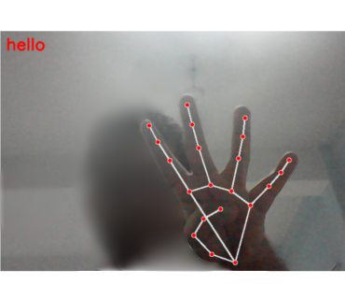

Slide 14
Thank You

